Slide 1
Machine Learning Foundation for Product Managers
Course assignment

Slide 2
Objective
To build a machine learning model to predict the electricity output of a Combined Cycle Power Plant

Slide 3
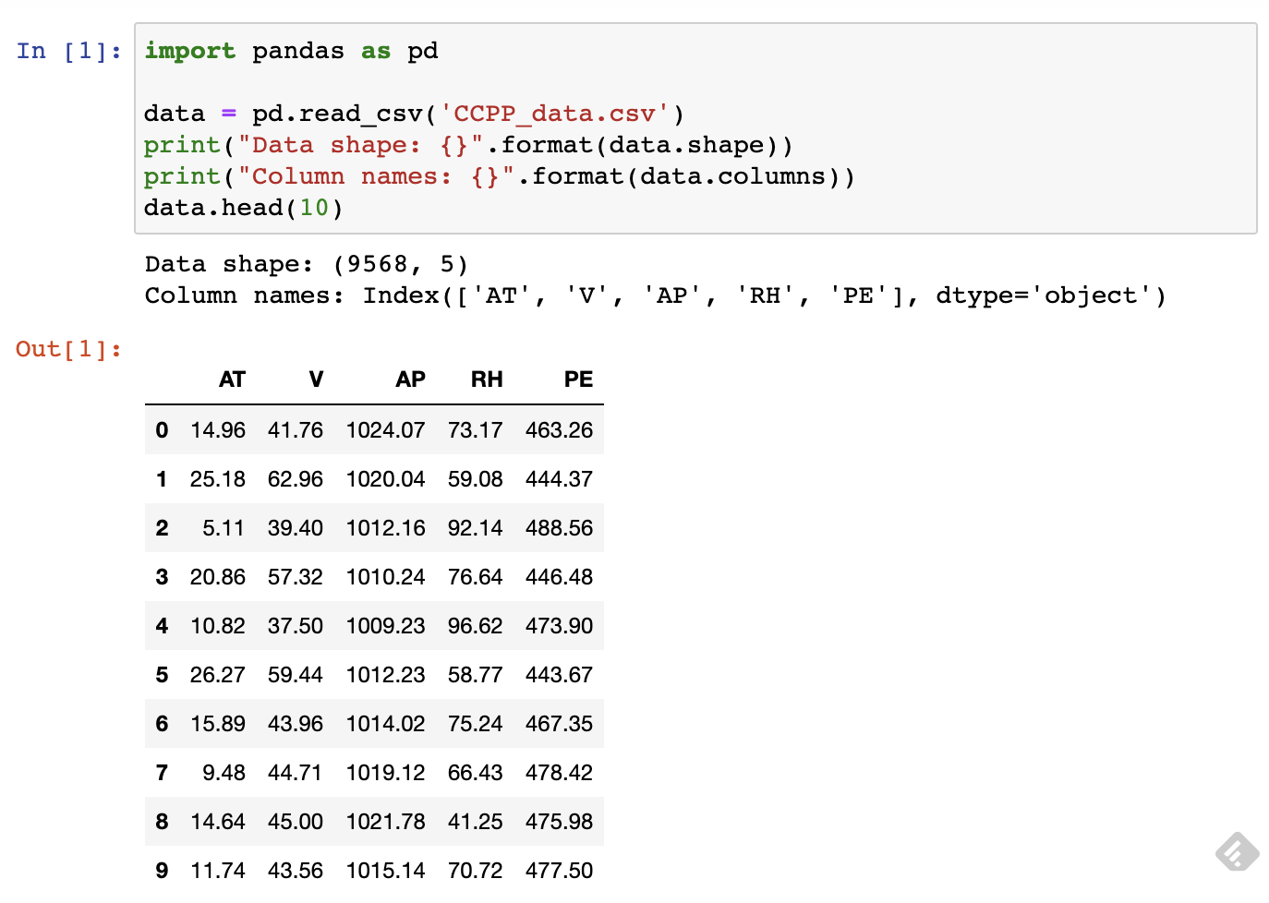
Exploratory Data Analysis [1/2]
The dataset contains 9,568 rows of records where each record is the hourly average ambient environmental readings from sensors at the power plant. There are 5 columns in the dataset, labelled as 'AT', 'V', 'AP', 'RH' & 'PE'.
AT: Average Temperature, in the range of 1.81°C (min) to 37.11°C (max)
V: Exhaust Vacuum , in the range of (min) 25.36 cm Hg to (max) 81.56 cm Hg
AP: Ambient Pressure, in the range of (min) 992.89 millibar to (max) 1033.30 millibar
RH: Relative Humidity, in the range of (min) 25.56% to (max) 100.16%
PE: Net hourly electrical energy output, in the range of (min) 420.26 MW to (max) 495.76 MW
PE is the target variable we are trying to predict for the machine learning model

Slide 4
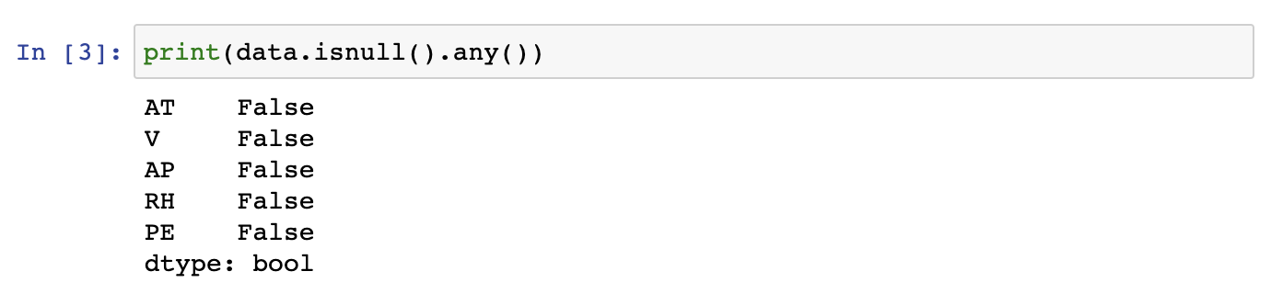
Exploratory Data Analysis [2/2]
We make sure that there are no missing data in the data set

Slide 5
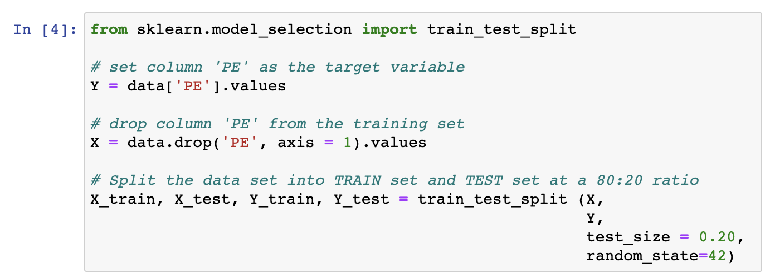
Modeling Approach
We now prepare the data for model training and validation. The steps are:
Assign column 'PE' as the Target Variable
Drop the column 'PE' from the training dataset
Split the training dataset into TRAIN set and TEST set at a 80:20 ratio

Slide 6
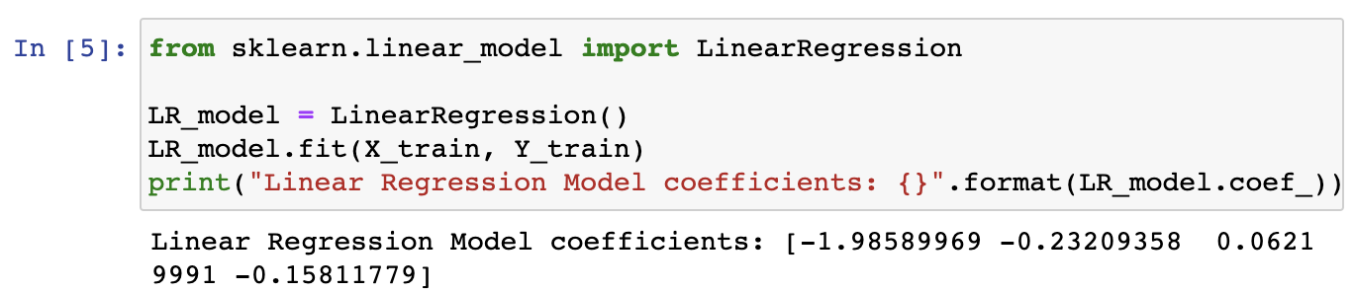
Linear Regression
A first model is a Linear Regression model – all the 4 columns are used as input parameters to predict the target variable 'PE'
R2 and Mean Square Error will be used to validate the Linear Regression model on the Test set.

Slide 7
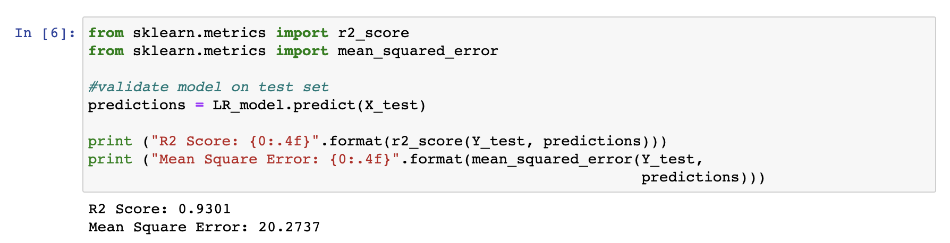
Linear Regression
R2 score is also known as the Coefficient of determination. It is used evaluate the performance of a linear regression model. It is used to check how well-observed results are reproduced by the model, depending on the ratio of total deviation of results described by the model.
Mean Square Error is an estimator measures the average of error squares (the average squared difference between the estimated values and true value). It is always non – negative and values close to zero are better.

Slide 8
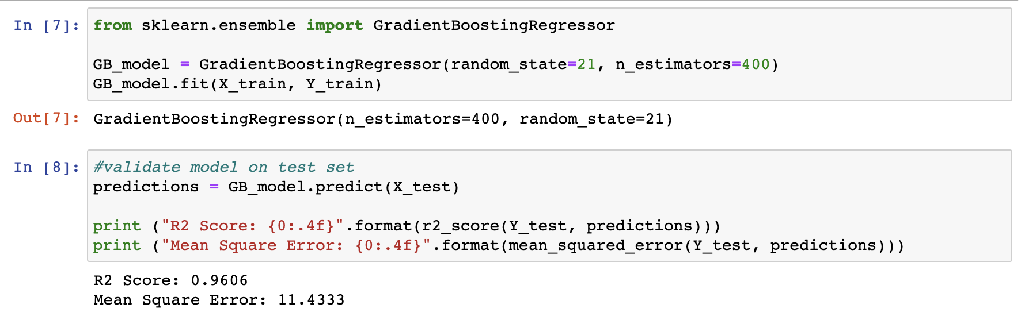
Gradient Boosting Regression
A Gradient Boosting Regression model is used as the second model for comparison. All the 4 columns are used as input parameters to predict the target variable 'PE'.
R2 and Mean Square Error will be used to validate the Gradient Boosting Regression model on the Test set.

Slide 9
A better regression model?
Given that the Gradient Boosting Regression model has a lower Mean Square Error (MSE) and a higher R2 Score compared to the Linear Regression model, the Gradient Boosting Regression model is a better ML model to use in this case

